Slide 1

SE401 - Software Quality Assurance and Testing
System Testing

Slide 2
Thought for the Day
“The principle objective of software testing is to give confidence in the software.”
– Anonymous

Slide 3
Outline
System Testing
Acceptance Testing
Functional System Testing
Risk-Based System Testing
Performance Testing
Summary

Slide 4
Objectives
Distinguish system and acceptance testing
How and why they differ from each other and from unit and integration testing
Understand basic approaches for quantitative assessment (reliability, performance, ...)
Understand interplay of validation and verification for usability and accessibility
How to continuously monitor usability from early design to delivery
Understand basic regression testing approaches
Preventing accidental changes
Notes:
4

Slide 5
System Testing
Functional Testing
Validates functional requirements
Performance Testing
Validates non-functional requirements
Acceptance Testing
Validates client’s expectations
Installation Testing
Impact of requirements on system testing:
The more explicit the requirements, the easier they are to test.
Quality of use cases determines the ease of functional testing
Quality of nonfunctional requirements and constraints determines the ease of performance tests
Notes:
When we are system testing, we are testing all subsystems together.
The requirements have a large impact on the quality of system testing:
The more explicit the requirements, the easier they are to test.
We distinguish the following types of system testing
Let’s walk through each of these system testing types

Slide 6
Functional Testing
Functional testing finds differences between functional requirements and the implemented system
Essentially the same as black box testing
Goal: Test functionality of system
Test cases are designed from the requirements analysis document (better: user manual) and centered around requirements and key functions (use cases)
Select tests that are relevant to the user and have a high probability of uncovering a failure
Use techniques like equivalence tests

Slide 7
System Testing
“Intuitively clear”
customer expectations
close to customer acceptance testing
BUT we need a better basis for really understanding system testing
Threads—the subject of system testing
How are they identified?
ad hoc?
from experience?
from a possibly incomplete requirements specification?
from an executable model? (Model-Based Testing)

Slide 8
Threads...
An execution time concept
Per the definition, a thread can be understood as a sequence of atomic system functions.
When a system test case executes
a thread occurs, and
can be observed at the port boundary of the system
The BIG Question: where do we find (or how do we identify) threads?
Our approach—Model-Based Testing

Slide 9
Threads
A “thread” is a portion of several modules that together provide a user-visible program feature.

Slide 10
Threads—Several Views
A scenario of normal usage
A use case
A stimulus/response pair
Behavior that results from a sequence of system-level inputs
An interleaved sequence of port input and output events
A sequence of transitions in a state machine description of the system
An interleaved sequence of object messages and method executions
A sequence of machine instructions
A sequence of source instructions
A sequence of atomic system functions (to be defined)

Slide 11
Some Choices—Threads in an ATM System
Entry of a digit
Entry of a personal identification number (PIN)
A simple transaction: ATM Card Entry, PIN Entry, select transaction type (deposit, withdraw), present account details (checking or savings, amount), conduct the operation, and report the results
An ATM session containing two or more simple transactions
Each of these can be understood as an interleaved sequence of port level inputs and outputs.

Slide 12
Details of PIN Entry as a Thread
A screen requesting PIN digits.
An interleaved sequence of digit keystrokes and screen responses.
The possibility of cancellation by the customer before the full PIN is entered.
A system disposition:
A customer has three chances to enter the correct PIN.
Once a correct PIN has been entered, the user sees a screen requesting the transaction type.
After three failed PIN En try attempts, a screen advises the customer that the ATM card will not be returned, and no access to ATM functions is provided.

Slide 13
Definition: Atomic System Function
Definition: An Atomic System Function (ASF) is an action that is observable at the system level in terms of port input and output events.
About ASFs
characterized by a sequence of port level inputs and outputs
could be just a simple stimulus/response pair (e.g. digit entry)
Sample ASFs in our ATM example
card entry
PIN entry
Transaction selection
session termination

Slide 14
More Definitions…
Given a system defined in terms of atomic system functions, the ASF Graph of the system is the directed graph in which nodes are ASFs and edges represent sequential flow.
A source ASF is an Atomic System Function that appears as a source node in the ASF graph of a system.
A sink ASF is an Atomic System Function that appears as a sink node in the ASF graph.
A system thread is a path from a source ASF to a sink ASF in the ASF graph of a system.

Slide 15
Requirements Specification
All of requirements specification models are developed on these basis concepts.
Data
Inputs to actions
Outputs of actions
Events
Inputs to actions
Outputs of actions
Actions
Threads (sequences of actions)
Devices

Slide 16
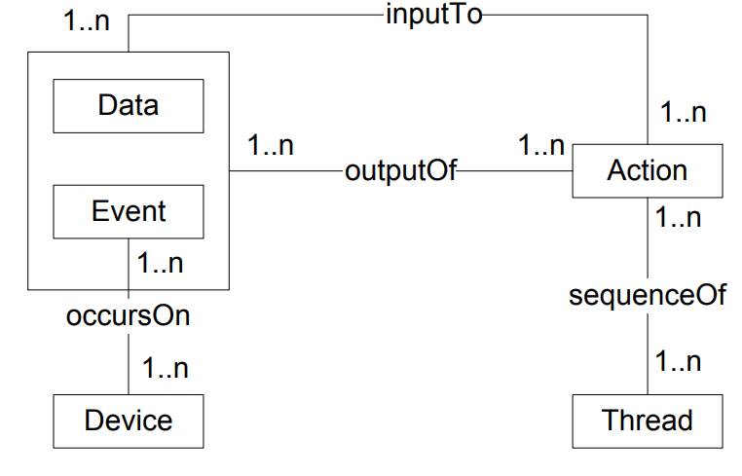
E/R Model of Basis Concepts

Slide 17
Sources of Threads
An “Expanded Essential Use Case”
pre-conditions
interleaved sequence of input and output events
post-conditions
A path in an executable model
finite state machine
Event-Driven Petri Net
Continuing example: the Simple ATM System (SATM)

Slide 18
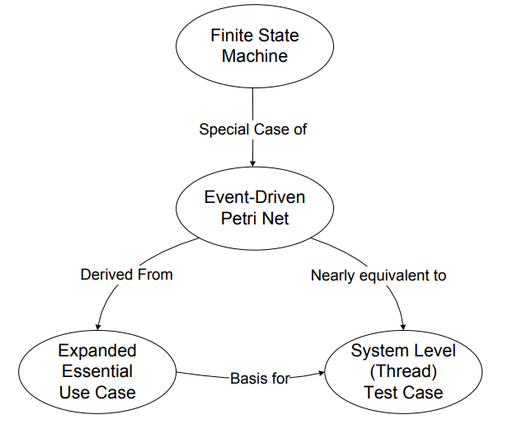
Sources of Threads—Model-Based Testing

Slide 19
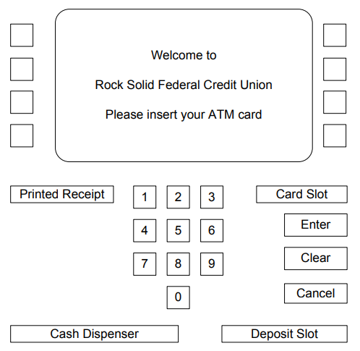
SATM System User Interface

Slide 20
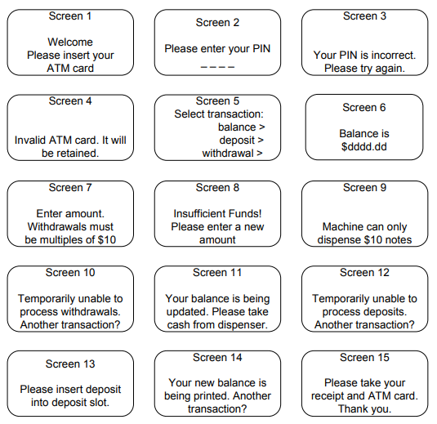
SATM System Screens

Slide 21
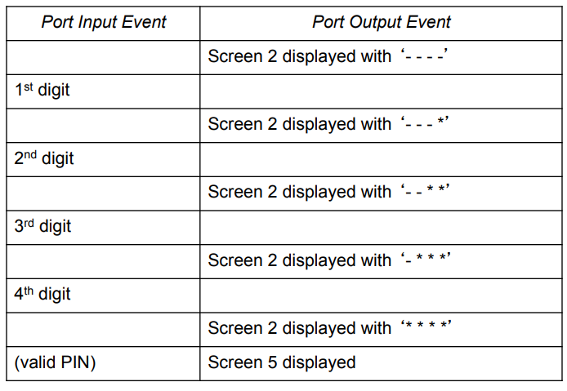
Port Event Sequence: Correct PIN on 1st Try

Slide 22
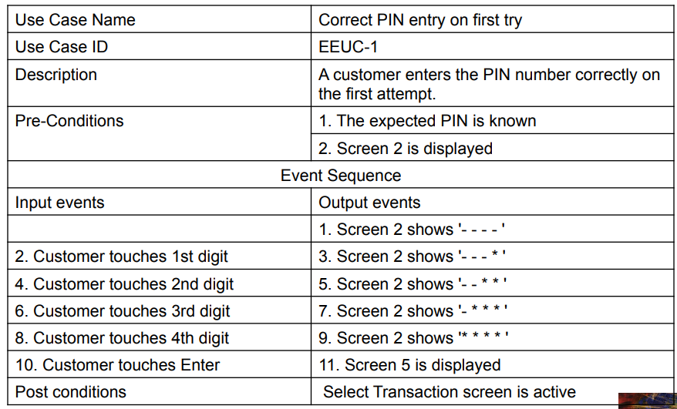
Use Case: Correct PIN on 1st Try

Slide 23
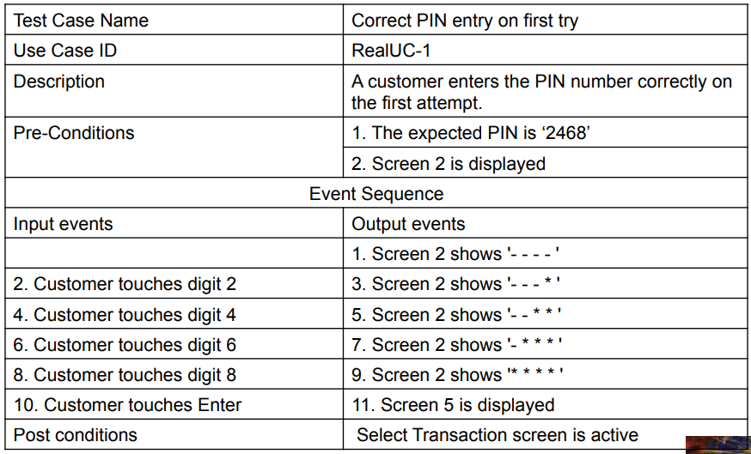
Test Case: Correct PIN on 1st Try

Slide 24
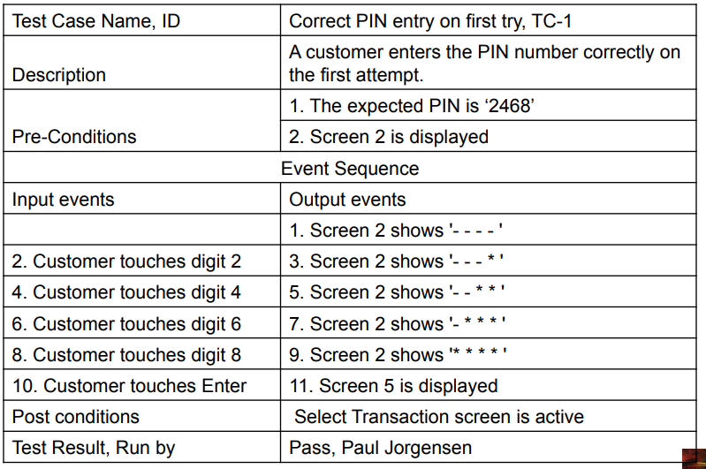
System Test Case: Correct PIN on 1st Try

Slide 25
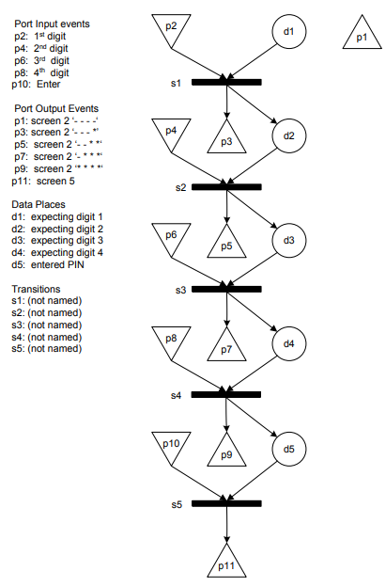
Event-Driven Petri Net of Correct PIN on First Try

Slide 26
Long versus Short Use Cases
A “Long” use case is typically an end-to-end transaction.
SATM example: A full traversal of the high level finite state machine, from the Welcome screen to the End Session screen: <s1, s2, s3, s4, s5>
A “Short” use case is at the level on an atomic system function.
Examples
PIN Entry
Transaction selection
Session closing

Slide 27
Short Use Cases
“Short” use case is at the level on an atomic system function (ASF).
In the directed graph of ASFs,
nodes are ASFs
edges signify possible sequential execution of ASFs
Consider an ASF as a “Short” use case, with
pre-conditions
post-conditions
Short use case (ASF) B can follow short use case (ASF) A if the pre-conditions of B are consistent with the post-conditions of A, that is...
Short use cases “connect” at their pre- and post condition boundaries.

Slide 28
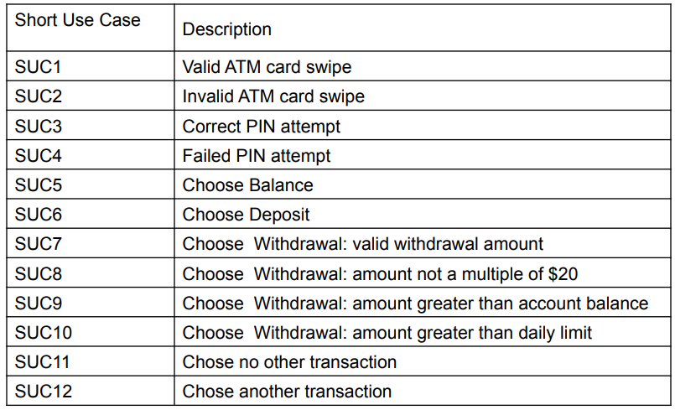
Short Use Cases for the SATM System

Slide 29
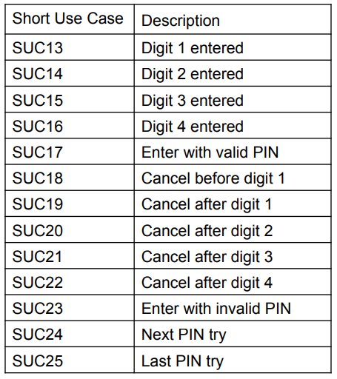
Short Use Cases for Failed PIN Attempts

Slide 30
How Many Use Cases?
1909 “long” use cases
25 “short” use cases
Ways to determine “how many?
Incidence with input events (cover every input event)
Incidence with output events (cover every output event)
Incidence with classes (need a use case/class incidence matrix)
These lead directly to system testing coverage metrics.

Slide 31
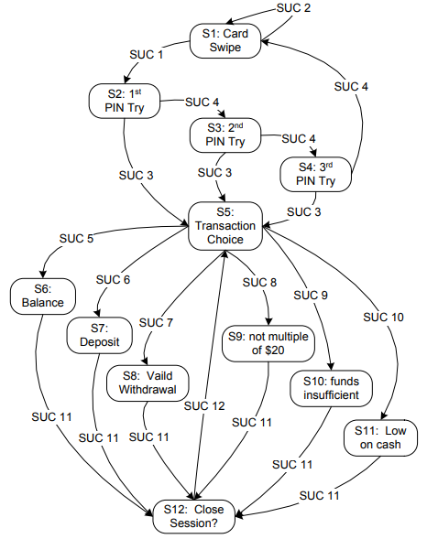
Short Use Cases for the SATM System

Slide 32
System Testing with Short Use Cases
Basic idea: a short use case is an atomic system function (ASF)
ASFs ...
begin with a port input event
end is one of possibly several port output events
ASFs can be identified
in source code
in executable models
from short use cases
Example: the integration version of NextDate

Slide 33
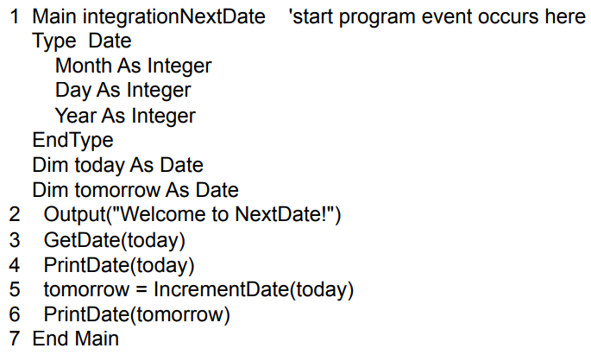
Integration Version: NextDate Pseudo-Code

Slide 34
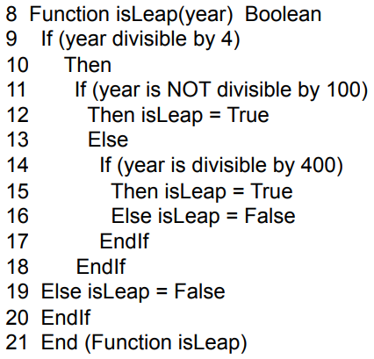
NextDate Pseudo-Code (continued)

Slide 35
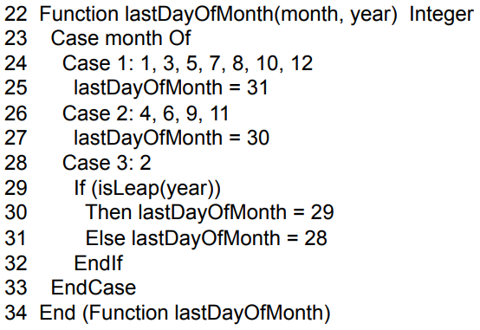
NextDate Pseudo-Code (continued)

Slide 36
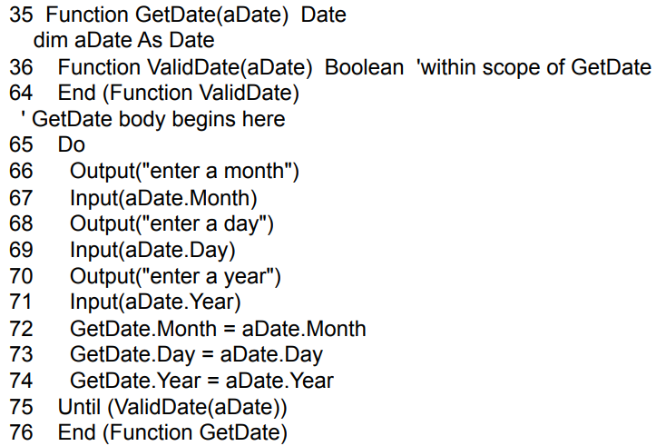
NextDate Pseudo-Code (continued)

Slide 37
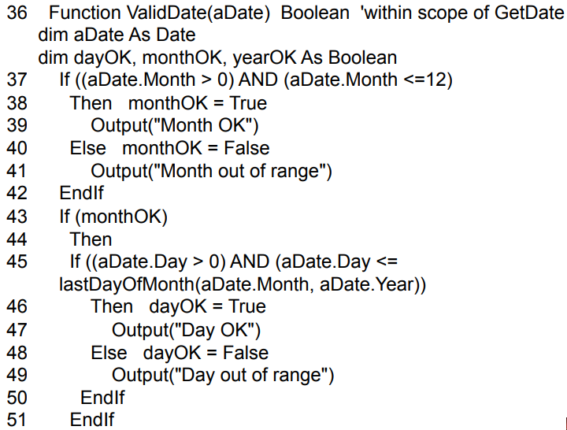
ValidDate Pseudo-Code

Slide 38
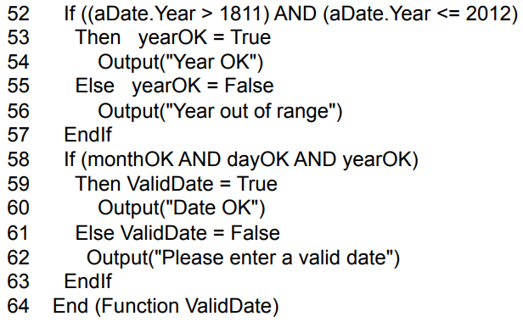
ValidDate Pseudo-Code (continued)

Slide 39
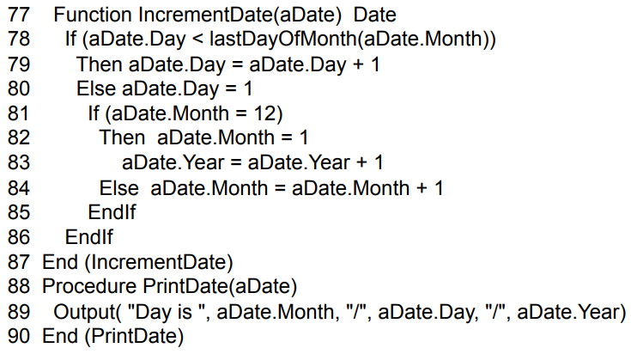
NextDate Pseudo-Code (continued)

Slide 40
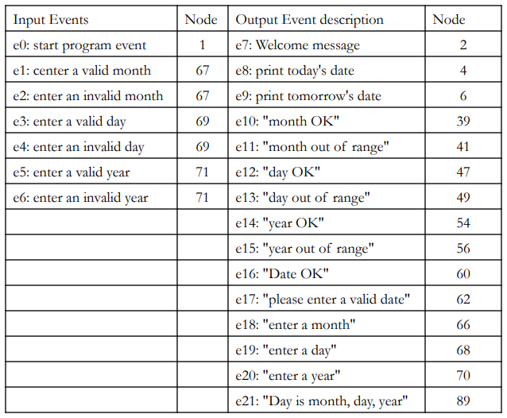
NextDate Input and Output Events

Slide 41
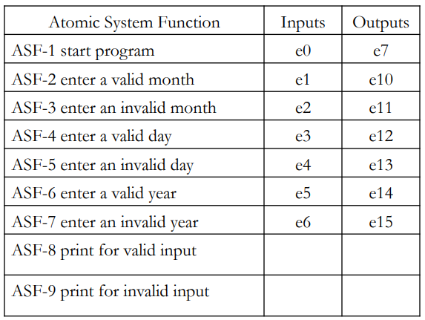
NextDate ASFs (first attempt)

Slide 42
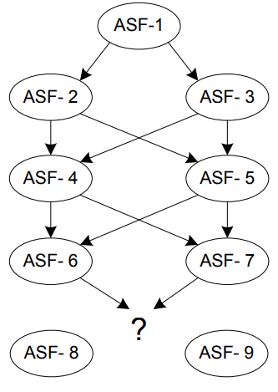
NextDate ASF Graph (transitions to ASF-8 and ASF-10 require memory)

Slide 43
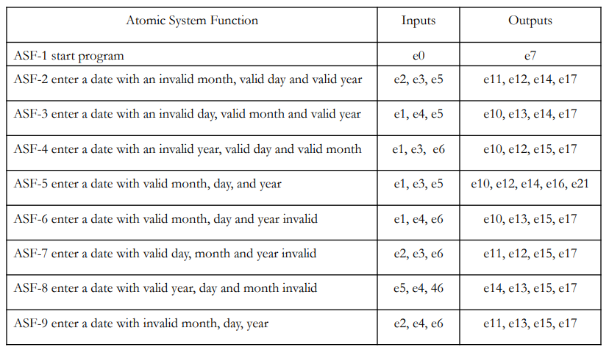
NextDate ASFs (second attempt)

Slide 44
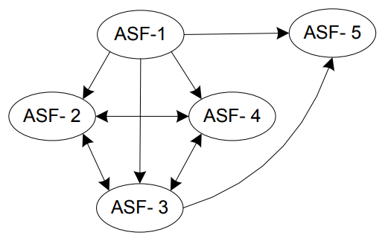
Improved NextDate ASF Graph (Very incomplete: can transit from most ASFs to most other ASFs.)

Slide 45
Metrics for System Testing
In PIN Entry, for a given PIN, there are 156 distinct paths from the First PIN Try state to the two successor states.
Of these, 31 correspond to eventually correct PIN entries.
1 on the first try
5 on the second try
25 on the third try
The other 125 paths correspond to failed PIN attempts/
Model-based coverage metrics can control this.

Slide 46
Model-Based Coverage Metrics
Decision table metrics
every condition
every action
every rule
Finite state machine metrics
every state
every transition
every path (cycles need to be addressed as in code coverage metrics)
Petri net metrics
every place
every port event
every transition
every marking

Slide 47
Risk-Based System Testing
Risk = Cost * (Probability of occurrence)
Hans Schaefer’s risk categories
Catastrophic: deposits, invalid withdrawals
Damaging: normal withdrawals
Hindering: invalid ATM card, PIN entry failure
Annoying: balance inquiries
Logarithmic weighting (low = 1, medium = 3, high = 10)

Slide 48
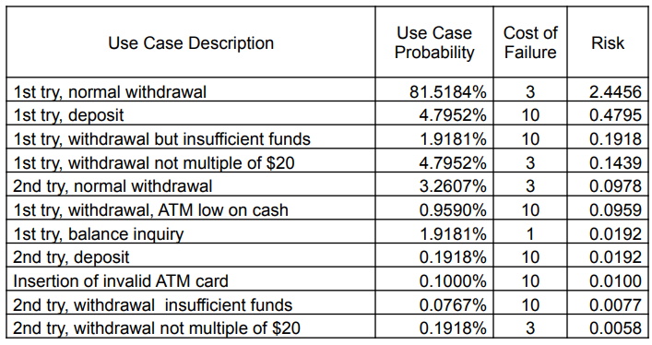
Selected Path Risks

Slide 49
Conclusions and Observations
System testing is based on threads
thread identification is the hard part
automated thread execution is a good idea
Model-Based system testing works well
Helpful to have system level coverage metrics

Slide 50
Performance Testing
Stress Testing
Checks if the system can respond to many simultaneous requests (maximum # of users, peak demands)
Volume testing
Test what happens if large amounts of data are handled
Configuration testing
Test the various software and hardware configurations
Compatibility test
Test backward compatibility with existing systems
Security testing
Try to violate security requirements

Slide 51
Performance Testing
Timing testing
Evaluate response times and time to perform a function
Environmental test
Test tolerances for heat, humidity, motion, portability
Quality testing
Test reliability, maintainability & availability of the system
Recovery testing
Tests system’s response to presence of errors or loss of data.
Human factors testing
Tests user interface with user

Slide 52
Test Cases for Performance Testing
Goal: Try to violate non-functional requirements
Push the (integrated) system to its limits.
Goal: Try to break the subsystem
Test how the system behaves when overloaded.
Can bottlenecks be identified? (First candidates for redesign in the next iteration)
Try unusual orders of execution
Call a receive() before send()
Check the system’s response to large volumes of data
If the system is supposed to handle 1000 items, try it with 1001 items.
What is the amount of time spent in different use cases?
Are typical cases executed in a timely fashion?

Slide 53
Acceptance Testing

Slide 54
Types of Acceptance Testing
Acceptance testing is a formal testing conducted to determine whether a system satisfies its acceptance criteria
There are two categories of acceptance testing:
User Acceptance Testing (UAT)
It is conducted by the customer to ensure that system satisfies the contractual acceptance criteria before being signed-off as meeting user needs.
Business Acceptance Testing (BAT)
It is undertaken within the development organization of the supplier to ensure that the system will eventually pass the user acceptance testing.

Slide 55
Types of Acceptance Testing
Three major objectives of acceptance testing:
Confirm that the system meets the agreed upon criteria
Identify and resolve discrepancies, if there is any
Determine the readiness of the system for cut-over to live operations

Slide 56
Acceptance Criteria
The acceptance criteria are defined on the basis of the following attributes:
Functional Correctness and Completeness
Accuracy
Data Integrity
Data Conversion
Backup and Recovery
Competitive Edge
Usability
Performance
Start-up Time
Stress
Reliability and Availability
Maintainability and Serviceability
Robustness
Timeliness
Confidentiality and Availability
Compliance
Installability and Upgradability
Scalability
Documentation

Slide 57
Acceptance Test Execution
The acceptance test cases are divided into two subgroups
The first subgroup consists of basic test cases, and
The second consists of test cases that are more complex to execute
The acceptance tests are executed in two phases
In the first phase, the test cases from the basic test group are executed
If the test results are satisfactory then the second phase, in which the complex test cases are executed, is taken up.
In addition to the basic test cases, a subset of the system-level test cases are executed by the acceptance test engineers to independently confirm the test results
Acceptance test execution activity includes the following detailed actions:
The developers train the customer on the usage of the system
The developers and the customer co-ordinate the fixing of any problem discovered during acceptance testing
The developers and the customer resolve the issues arising out of any acceptance criteria discrepancy

Slide 58
Acceptance Testing
Goal: Demonstrate system is ready for operational use
Choice of tests is made by client
Many tests can be taken from integration testing
Majority of all bugs in software is typically found by the client after the system is in use, not by the developers or testers. Therefore two kinds of additional tests:
Alpha test:
Sponsor uses the software at the developer’s site.
Software used in a controlled setting, with the developer always ready to fix bugs.
Beta test:
Conducted at sponsor’s site (developer is not present)
Software gets a realistic workout in target environment
Potential customer might get discouraged

Slide 59
System Testing

Slide 60
System Testing
Key characteristics:
Comprehensive (the whole system, the whole spec)
Based on the specification of observable behavior
Verification against a requirements specification, not validation, and not opinions
Independent of design and implementation
Avoid repeating software design errors in system test design

Slide 61
What is System Testing?
 | System | Acceptance | Regression
Test for ... | Correctness, completion | Usefulness, satisfaction | Accidental changes
Test by ... | Development test group | Test group with users | Development test group
 | Verification | Validation | Verification

Slide 62
Independent V&V
One strategy for maximizing independence:
System (and acceptance) test performed by a different organization
Organizationally isolated from developers
no pressure to say “ok”
Sometimes outsourced to another company or agency
Especially for critical systems
Outsourcing for independent judgment, not to save money
May be additional system test, not replacing internal V&V
Not all outsourced testing is IV&V
Not independent if controlled by development organization

Slide 63
Achieving Independence Without Changing Staff
If the development organization controls system testing ...
Perfect independence may be unattainable, but we can reduce undue influence
Develop system test cases early
As part of requirements specification, before major design decisions have been made
Agile “test first”
Conventional “V model”
Critical system testing early in project

Slide 64
Incremental System Testing
System tests are often used to measure progress
System test suite covers all features and scenarios of use
As project progresses, the system passes more and more system tests
Assumes a “threaded” incremental build plan:
Features exposed at top level as they are developed

Slide 65
Global Properties
Some system properties are inherently global
Performance, latency, reliability, ...
Early and incremental testing is still necessary, but provide only estimates
A major focus of system testing
The only opportunity to verify global properties against actual system specifications
Especially to find unanticipated effects, e.g., an unexpected performance bottleneck

Slide 66
Context-Dependent Properties
Beyond system-global: Some properties depend on the system context and use
Example: Performance properties depend on environment and configuration
Example: Privacy depends both on system and how it is used
Medical records system must protect against unauthorized use, and authorization must be provided only as needed
Example: Security depends on threat profiles
And threats change!
Testing is just one part of the approach

Slide 67
Establishing an Operational Envelope
When a property (e.g., performance or real-time response) is parameterized by use ...
requests per second, size of database, ...
Extensive stress testing is required
varying parameters within the envelope, near the bounds, and beyond
Goal: A well-understood model of how the property varies with the parameter
How sensitive is the property to the parameter?
Where is the “edge of the envelope”?
What can we expect when the envelope is exceeded?

Slide 68
Stress Testing
Often requires extensive simulation of the execution environment
With systematic variation: What happens when we push the parameters? What if the number of users or requests is 10 times more, or 1000 times more?
Often requires more resources (human and machine) than typical test cases
Separate from regular feature tests
Run less often, with more manual control
Diagnose deviations from expectation
Which may include difficult debugging of latent faults!

Slide 69
Acceptance Testing
Estimating dependability
Measuring quality, not searching for faults
Fundamentally different goal than systematic testing
Quantitative dependability goals are statistical
Reliability
Availability
Mean time to failure
...
Requires valid statistical samples from operational profile
Fundamentally different from systematic testing
Notes:
The systematic testing techniques discussed in previously (specification-based testing, structural testing, model-based testing, et al) are all designed to make the search for faults as effective as possible. They are intentionally “biased” to take more samples where we think faults might be. Statistical measures of dependability require, instead, unbiased samples from the population of operational behaviors.

Slide 70
Statistical Sampling
We need a valid operational profile (model)
Sometimes from an older version of the system
Sometimes from operational environment (e.g., for an embedded controller)
Sensitivity testing reveals which parameters are most important, and which can be rough guesses
And a clear, precise definition of what is being measured
Failure rate? Per session, per hour, per operation?
And many, many random samples
Especially for high reliability measures

Slide 71
Is Statistical Testing Worthwhile?
Necessary for ...
Critical systems (safety critical, infrastructure, ...)
But difficult or impossible when ...
Operational profile is unavailable or just a guess
Often for new functionality involving human interaction
But we may factor critical functions from overall use to obtain a good model of only the critical properties
Reliability requirement is very high
Required sample size (number of test cases) might require years of test execution
Ultra-reliability can seldom be demonstrated by testing

Slide 72
Process-Based Measures
Less rigorous than statistical testing
Based on similarity with prior projects
System testing process
Expected history of bugs found and resolved
Alpha, beta testing
Alpha testing: Real users, controlled environment
Beta testing: Real users, real (uncontrolled) environment
May statistically sample users rather than uses
Expected history of bug reports
Notes:
An early release of half-baked software is not what we mean by alpha and beta testing.
Note that today “alpha” and “beta” are often used informally, but here we are using them in their established technical sense for a testing process.
An alpha test involves bringing users on-site to use the system.
A beta test means providing the software to a controlled sample of users to use the system in their own environment.
In both cases, to make any reasonable inference of dependability we need a valid sample of users.
Using the history of system testing was discussed in Chapter 20, Planning and monitoring, and is illustrated

Slide 73
UI testing ("acceptance")
Automated UI testing ("automation")
Scripts and such that use your app and look for failures
A black-box system test
Manual tests
Human beings click through predetermined paths
Need to write down the specific tests each time
Ad-hoc tests
Human beings are "turned loose" on the app to see if they can break it

Slide 74
Usability Test
A usable product
is quickly learned
allows users to work efficiently
is pleasant to use
Objective criteria
Time and number of operations to perform a task
Frequency of user error
Plus overall, subjective satisfaction

Slide 75
Load testing
load testing
How many hits/requests should the system be able to handle?
What should be its performance under these circumstances?

Slide 76
Accessibility Testing
Check usability by people with disabilities
Blind and low vision, deaf, color-blind, ...
Use accessibility guidelines
Direct usability testing with all relevant groups is usually impractical; checking compliance to guidelines is practical and often reveals problems
Example: W3C Web Content Accessibility Guidelines
Parts can be checked automatically
but manual check is still required
e.g., is the “alt” tag of the image meaningful?

Slide 77
Installation Testing
Before the testing
Configure the system
Attach proper number and kind of devices
Establish communication with other system
The testing
Regression tests: to verify that the system has been installed properly and works

Slide 78
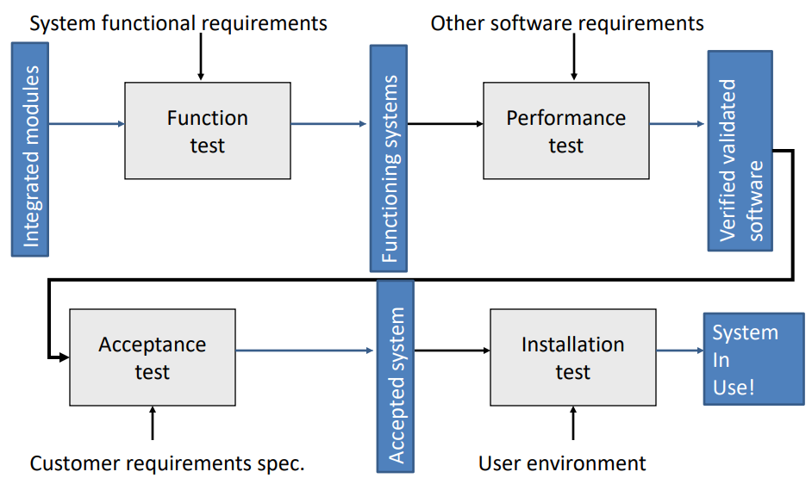

Slide 79
Summary
System testing is verification
System consistent with specification?
Especially for global properties (performance, reliability)
Acceptance testing is validation
Includes user testing and checks for usability
Usability and accessibility require both
Usability testing establishes objective criteria to verify throughout development
Notes:
79

